Slide 1

Product Design
SchemeMatch AI
Project
Resource by Oliver Engel · oliverengel.com

Slide 2
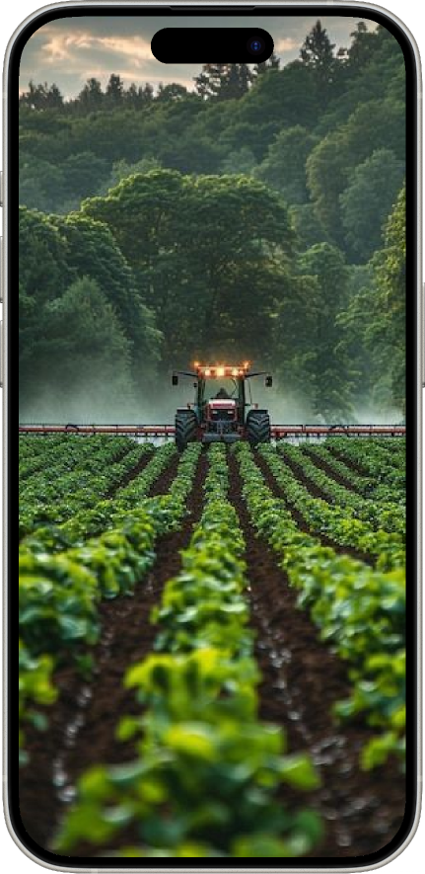
Project title
helping farmers to find schemes
Organiser
Capital one
Role
Students in VLITS
Length
July 30- August 18
Team
Sravya, Naveena, Chandrika, Bhavitha
Year
2025

Slide 3


Process
Helping farmers to know what kind of schemes their eligible to.........
spreading awareness

Slide 4
Agenda
1
Home page
2
Details
3
recomandations
4
Feedback

Slide 5




SchemeMatch AI
Home
About
Contact
Get Started
Featured Schemes
Family Support Program
Entrepreneurship Grant
Senior Citizen Assistance
Provides financial assistance and resources for families with children.
Offers grants and mentorship for aspiring entrepreneurs and small businesses.
Supports senior citizens with healthcare, housing, and financial aid.

Slide 6

SchemeMatch AI
Home
Schemes
Dashboard
Support
Government Scheme Matchmaker AI
Name
Enter your full name
Age
Enter your age
State
Select your state
District
Select your district
Category
Select your category
Landholding (in acres)
Enter your landholding
Crop Type
Select your crop type
Irrigation Access
Select irrigation access
Annual Income (in INR)
Enter your annual income
Submit

Slide 7





SchemeMatch AI
Dashboard
Profile
Support
Search
Your Scheme Recommendations
Based on your profile, we've identified the following government schemes that may be beneficial for you.
Small Business Support Initiative
This scheme offers financial assistance and mentorship to small businesses in the tech sector. Benefits include low-interest loans and access to industry experts.
Learn More
Green Energy Incentive Program
Provides subsidies for installing solar panels and other renewable energy systems in homes and businesses. Eligibility requires a property assessment.
Apply Now
Skill Development Grant
Offers grants for individuals seeking to upgrade their skills through certified training programs. Covers a wide range of courses from digital marketing to data science.
Learn More
Rural Healthcare Access Fund
A fund aimed at improving healthcare access in rural areas by providing financial support to healthcare professionals and facilities.
Apply Now

Slide 8



SchemeMatch AI
Dashboard
Profile
Support
Search
Your Scheme Recommendations
Based on your profile, we've identified the following government schemes that may be beneficial for you.
Small Business Support Initiative
This scheme offers financial assistance and mentorship to small businesses in the tech sector. Benefits include low-interest loans and access to industry experts.
Learn More
Feedback
Very Relevant
Relevant
Neutral
Not Relevant
Very Not Relevant
Green Energy Incentive Program
Provides subsidies for installing solar panels and other renewable energy systems in homes and businesses. Eligibility requires a property assessment.
Apply Now
Feedback
Very Relevant
Relevant
Neutral
Not Relevant
Very Not Relevant
Skill Development Grant
Offers grants for individuals seeking to upgrade their skills through certified training programs. Covers a wide range of courses from digital marketing to data science.
Learn More
Feedback
Very Relevant
Relevant
Neutral
Not Relevant
Very Not Relevant
Rural Healthcare Access Fund
A fund aimed at improving healthcare access in rural areas by providing financial support to healthcare professionals and facilities.
Apply Now
Feedback
Very Relevant
Relevant
Neutral
Not Relevant
Very Not Relevant

Slide 9


